Slide 1



Introduction to Inventory Management System
This presentation will provide an overview of the key components of our comprehensive Inventory Management System, covering the main database tables that enable efficient tracking, monitoring, and analysis of our inventory and sales operations.
by Mashhood Farqaleet .

Slide 2
TABLES
Dropshipped_Products
Warehouse_Products
Shopify_Store
Orders
Users
Sales
Credential
Amazon_Store

Slide 3
Dropshipped_Products
dropship_id (PK)
product_name
site_link
original_price
sale_price
Warehouse_Products
warehouse_id (PK)
product_name
quantity
till_sold
original_price
sale_price

Slide 4
4.Orders
order_id (PK)
Store_p_id (FK)
quantity
price
order_date
order_time
delivery_date
user_id (FK)
payment_method
3.Shopify_Store
Store_p_id (PK)
name
dropship_id (FK)
a_id (FK)
price
margin

Slide 5
Users
user_id (PK)
username
order_id (FK)
email
Date_joined
Amazon_Store
amazon_id (PK)
house_id (FK)
name
product_fulfillment(Done/Pending)
Date_send
price
Margin
Sales
sale_id (PK)
order_id (FK)
date_placed
date_delivery
price
Employees_data
e_id (PK)
name, post
email ,phone_no,CNIC
Salary
Date_joined
Experience
Currently_active

Slide 6
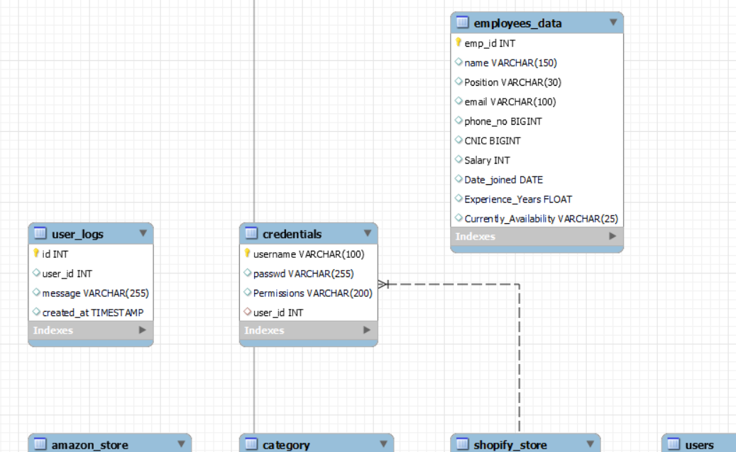
DB SCHEMA
ERD

Slide 7
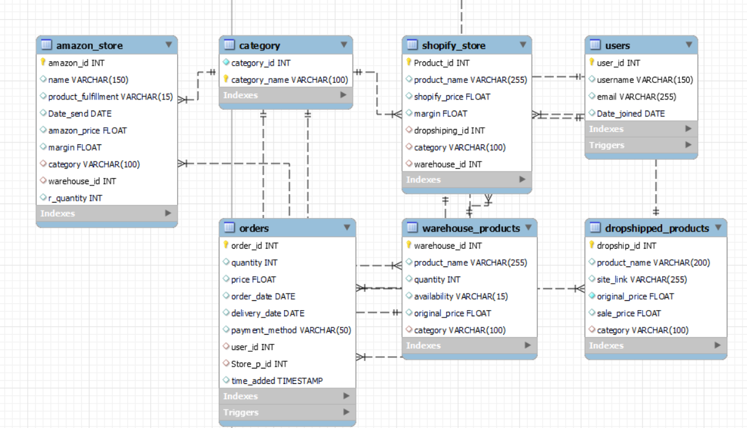

Slide 8
MODULES
update_shopify_price:
Functionality: Updates the price of a product in the Shopify store based on the provided product ID.
delete_amazon_product:
Functionality: Deletes a product from the Amazon store based on the provided Amazon ID.
get_orders_by_user:
Functionality: Retrieves orders placed by a specific user identified by their user ID.
get_all_products_and_categories:
Functionality: Retrieves all products along with their categories, providing a comprehensive view of available products.
update_order_delivery_date:
Functionality: Updates the delivery date of an order based on the provided order ID and new delivery date.

Slide 9
get_total_sales:
Functionality: Calculates the total sales amount for a specific order identified by its order ID.
get_total_quantity_by_category:
Functionality: Retrieves the total quantity of products belonging to a specific category.
get_dropshipped_product_name:
Functionality: Retrieves the name of a dropshipped product based on the provided dropship ID.
get_employee_name:
Functionality: Retrieves the name of an employee based on the provided employee ID.

Slide 10
TRIGGERS
update_orders:
Functionality: Updates the time_added column with the current timestamp before inserting a new record into the orders table.
after_user_insert:
Functionality: Generates a welcome message for a newly inserted user and logs it into the user_logs table after each user insertion.
calculate_order_total:
Functionality: Automatically calculates the total amount of an order by summing up the prices of individual items whenever a new order is inserted.
track_order_status_changes:
Functionality: Logs changes in the status of orders, providing a history of order status updates for auditing and tracking purposes

Slide 11
Dropshipped Products
Tracking Dropshipped Items
Supplier Integration
Analytics and Reporting
This table seamlessly integrates with our supplier systems, automatically updating inventory levels and fulfillment details to ensure a smooth dropshipping experience.
With this table, we can analyze trends in dropshipped sales, identify popular products, and optimize our dropshipping strategy for maximum profitability.
The Dropshipped_Products table allows us to closely monitor all items that are dropshipped directly to customers, including order details, shipping status, and customer information.

Slide 12
Warehouse Products
Inventory Tracking
Warehouse Operations
The Warehouse_Products table provides a comprehensive view of all in-stock iventory, including quantities, locations, and product details.
The table integrates with our warehouse management system, streamlining processes like receiving, picking, and shipping of in-house inventory.
1
2
3
Replenishment Alerts
This table triggers low-stock notifications, allowing us to proactively reorder products and maintain optimal inventory levels.

Slide 13
Online Sales Channels
Shopify Store Integration
Amazon Store Integration
Multichannel Analytics
The Shopify_Store table synchronizes our online product catalog, orders, and customer data, providing a seamless omnichannel experience.
The Amazon_Store table integrates our inventory, pricing, and fulfillment data with the Amazon marketplace, enabling us to reach a wider customer base.
Together, these tables allow us to analyze sales performance, customer behavior, and inventory dynamics across all our online sales channels.

Slide 14
Customer Orders
Order Details
Fulfillment Tracking
The Orders table captures comprehensive information about each customer order, including items purchased, quantities, shipping details, and payment methods.
This table integrates with our shipping providers to monitor order status and facilitate timely delivery of products to customers.
Customer Insights
Reporting and Analytics
The order data enables us to analyze customer purchasing patterns, identify top-selling products, and optimize our marketing and inventory strategies.
The Orders table serves as a central hub for generating sales reports, revenue forecasts, and other valuable business intelligence.

Slide 15



User Management
Users
Credentials
Access Control
The Users table stores essential information about employees and authorized users, such as their names, roles, and contact details.
The Credentials table manages user login credentials, ensuring secure access to the Inventory Management System based on their assigned permissions.
Together, these tables enable us to establish and maintain a robust user authentication and authorization framework for the system.

Slide 16
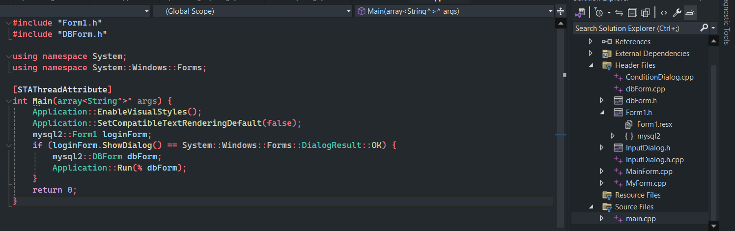
GUI with C++

Slide 17

Login Interface

Slide 18
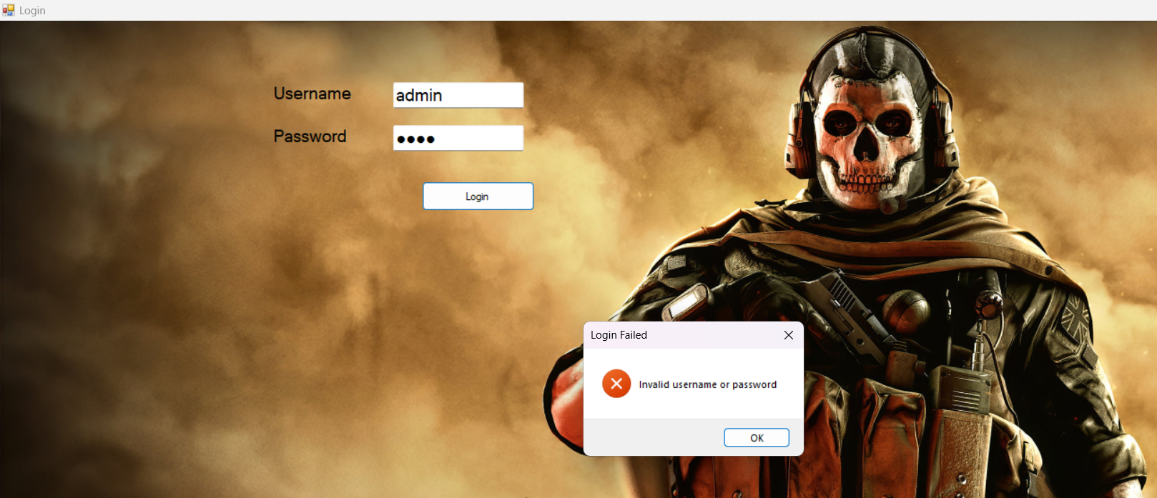

Slide 19
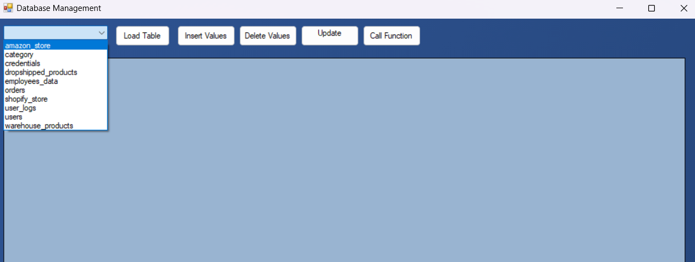
DATABASE Tables Menu

Slide 20
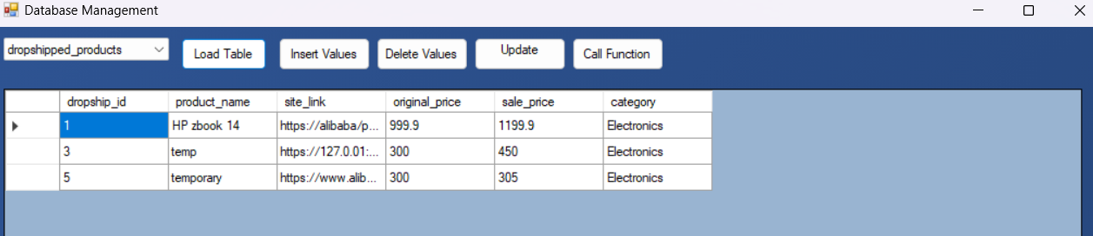
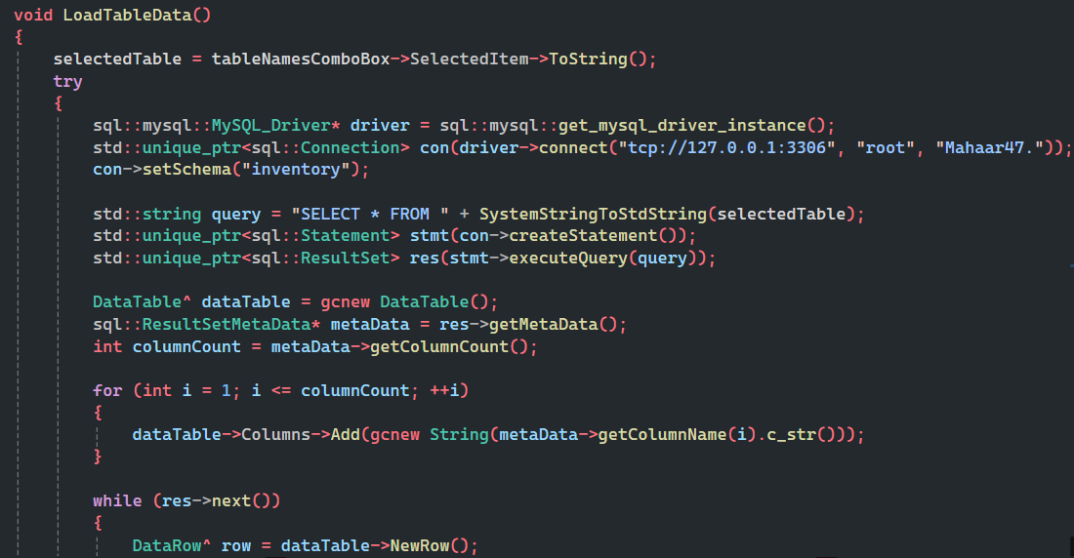

Slide 21
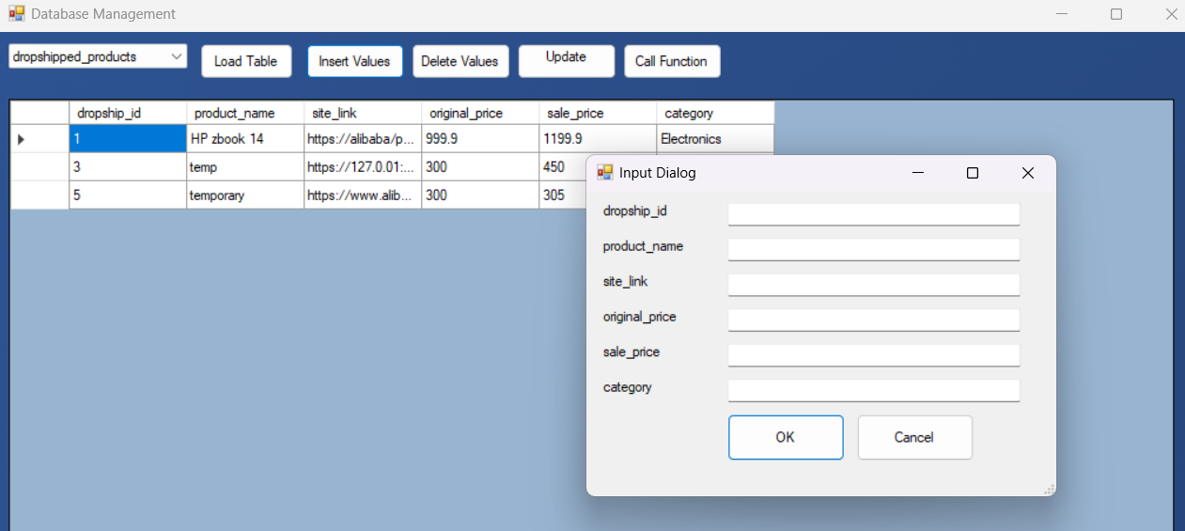

Slide 22
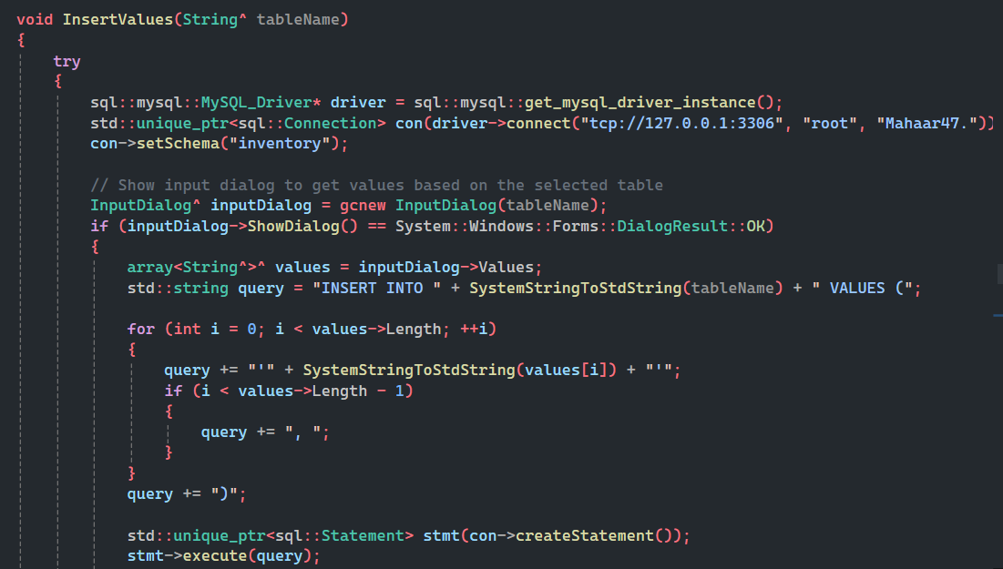

Slide 23
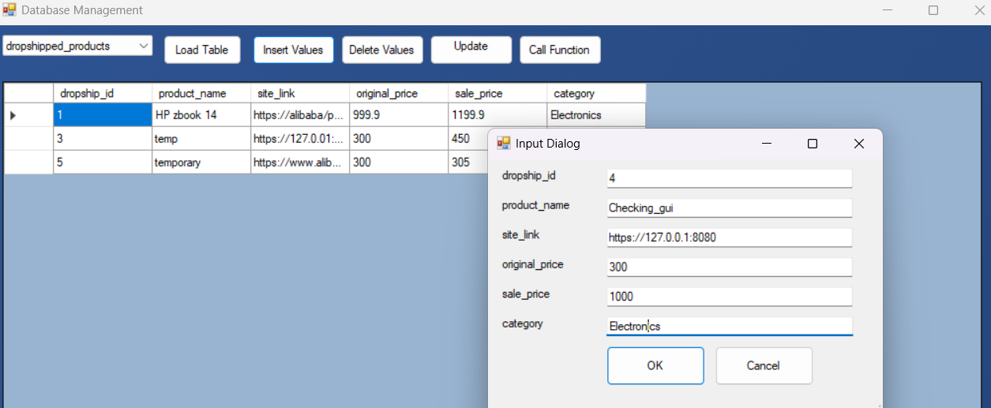
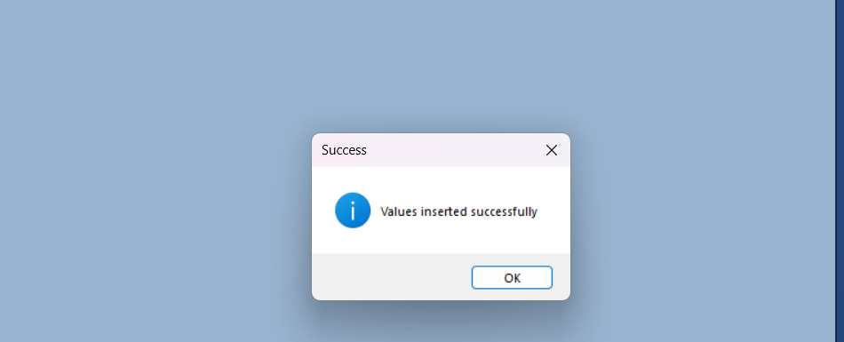

Slide 24
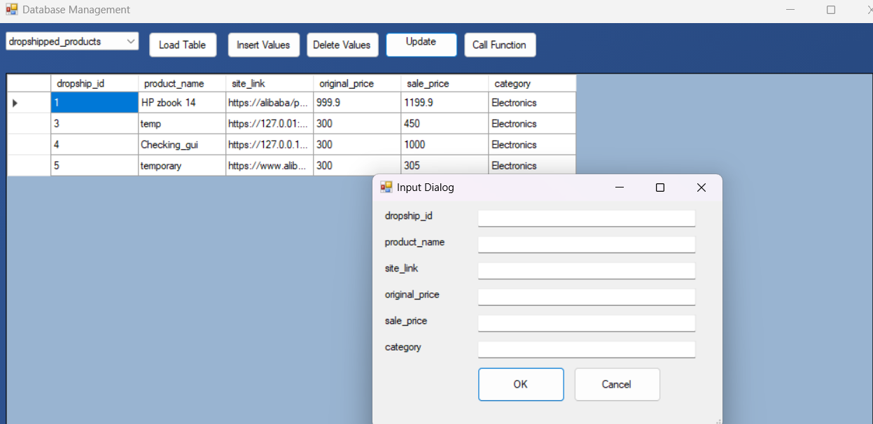
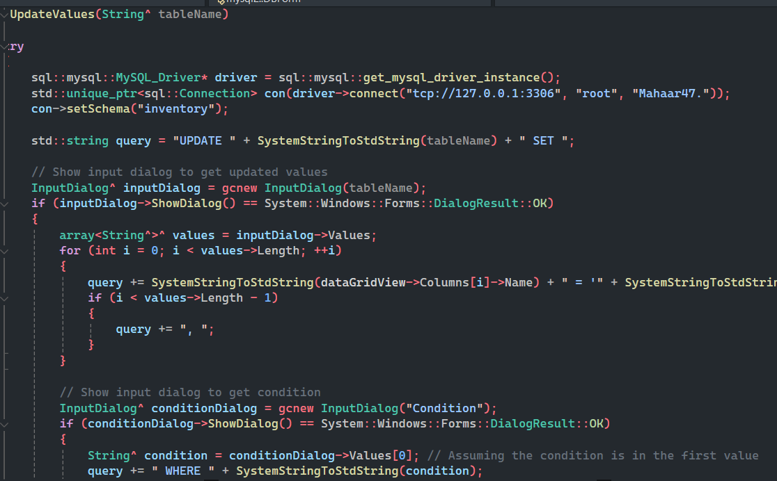

Slide 25




Performance and Analytics
Sales Data
The Sales table captures detailed information about every transaction, including revenue, profit margins, and sales channels.
Employee Performance
The Employees_data table tracks key metrics on employee productivity, such as sales figures, customer satisfaction, and task completion rates.
Comprehensive Insights
By analyzing the data from these tables, we can gain valuable insights to optimize sales strategies, improve operational efficiency, and empower our workforce.

Slide 26
Conclusion: Leveraging the Database for Efficient Inventory Management
Comprehensive Inventory Tracking
Seamless Omnichannel Integration
Detailed Order Management
Secure User Access and Authentication
Real-time Inventory Visibility
Multichannel Sales Analytics
Customer Insights and Reporting
Performance Optimization and Workforce Empowerment
In conclusion, this robust Inventory Management System, powered by the comprehensive database, enables us to streamline our inventory operations, enhance customer experience, and drive continuous improvement across all aspects of our business.

